Slide 1
SECURE DATA HIDE IN IMAGE USING STEGANOGRAPHY
CAPSTONE PROJECT
Presented By: VUYYURU NIROSHA
Student Name : VUYYURU NIROSHA
College Name & Department : SNIST & EEE

Slide 2
OUTLINE
Problem Statement
Technology used
Wow factor
End users
Result
Conclusion
Git-hub Link
Future scope

Slide 3
Problem Statement
This project provides a simple implementation of image based steganography , where secret messages are hidden within an image and later retrieved using a decryption script. The encryption and decryption processes involvemodifying the pixel values of an image to store the message bytes.

Slide 4
Technology used
Libaraies used : OpenCV2
Coding language used: Python
Operaing sytem : Windows 10

Slide 5
Wow factors
Features
Hide a secret message inside an image using pixel manipulation
Secure the message with a password
Extract the hidden message only with the correct password
Simple and lightweight implementation using python and openCV

Slide 6
End users
End users of Steganography are Army , journalists, government agencies ,banking agencies ,etc who use technology to hide the sensitive data discreetly with high protection for various purposes like secure communication or concealing malicious activity from detection.

Slide 7
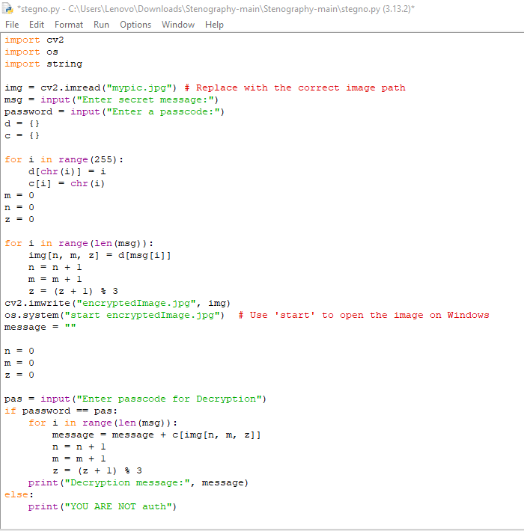
Results
Code

Slide 8

2. Image (715Kb)

Slide 9

3. Encrypted image (1.39MB)

Slide 10
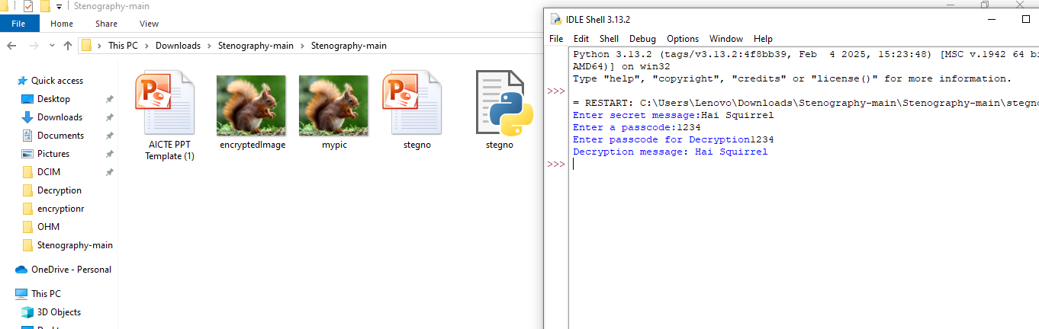
4. Output

Slide 11
Conclusion
In this project of securing data hidden in image using steganography the encryption process replaces pixel values with message bytes. The message length should not exceed the image size. A null byte is used as an end marker to detect the message.
Steganography is used now a days widely by any firms who want to cummincate or tranmit their sensitive data wth highly discreet method.
This project helps in using python and openCV to implement Steganography.

Slide 12
GitHub Link
https://github.com/NiroshaVuyyuru/Secure-data-hiding-in-image-steganography.git

Slide 13
THANK YOU

